Slide 1
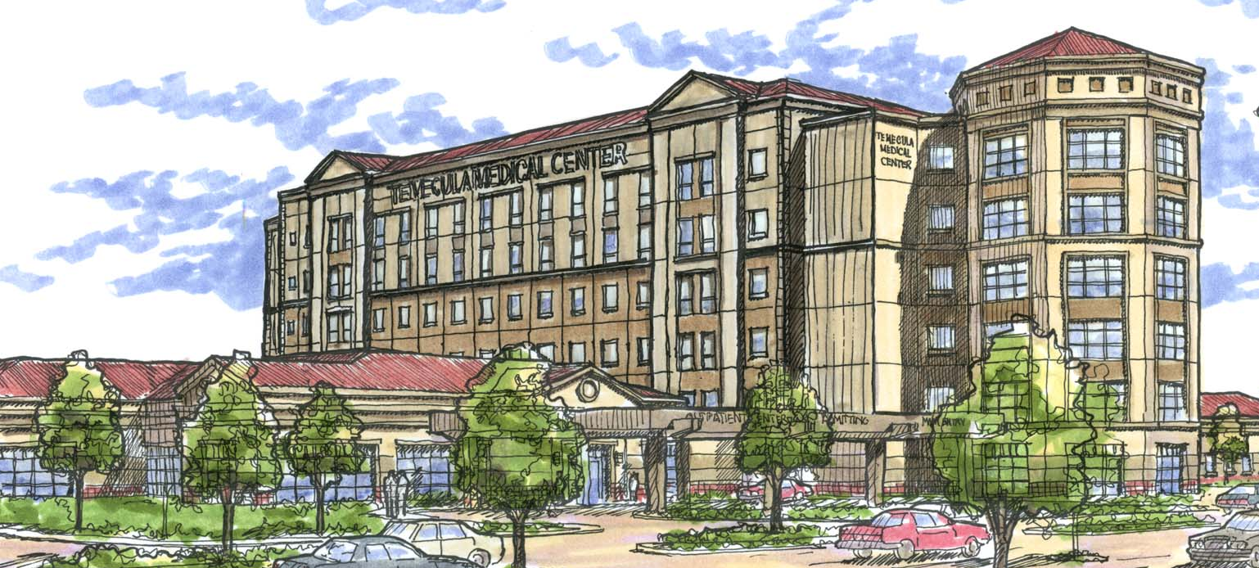
TEMECULA MEDICAL CENTER
TEMECULA, CA
“STRUCTURAL SYSTEM OPTIMIZATION”
IMAGE COUTESY OF THE HKS INC.
THE DEPARTMENT OF ARCHITECTURAL ENGINEERING
AT
THE PENNSYLVANIA STATE UNIVERSITY
APRIL 13, 2009
SEAN BEVILLE
STRUCTURAL OPTION
ADVISOR: PROF. BOOTHBY

Slide 2
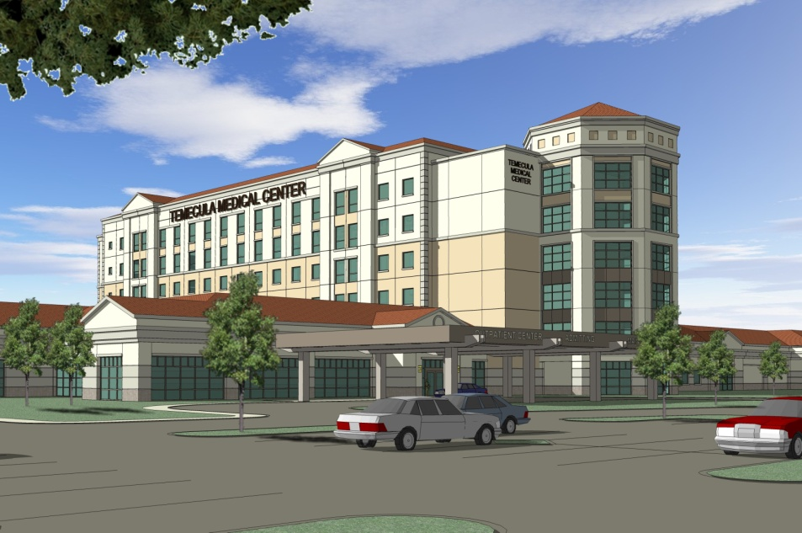
PRESENTATION OUTLINE
THESIS GOALS
BUILDING INTRODUCTION
STRUCTURAL DEPTH
STRUCTURE CHANGES
GRAVITY/LATERAL
RECOMMENDATIONS
CM BREADTH
INTRODUCTION
COMPARISONS
RECOMMENDATIONS
ARCHITECTURAL BREADTH
FAÇADE CHANGES
SUNLIGHT CHANGES
RECOMMENDATIONS
RECAP & FINAL RECOMMENDATIONS
QUESTIONS
PRESENTATION OUTLINE
THESIS GOALS
BUILDING INTRO
STRUCTURAL DEPTH
CM BREADTH
ARCHITECTURAL BREADTH
SUMMARY
&
RECOMMENDATIONS
THANK YOU
QUESTIONS
APRIL 13, 2009
SEAN BEVILLE
STRUCTURAL OPTION
ADVISOR: PROF. BOOTHBY

Slide 3
THESIS GOALS
PRESENTATION OUTLINE
THESIS GOALS
BUILDING INTRO
STRUCTURAL DEPTH
CM BREADTH
ARCHITECTURAL BREADTH
SUMMARY
&
RECOMMENDATIONS
THANK YOU
QUESTIONS
Analysis existing conditions/surrounding region
Optimize new steel structure
Analyze construction feasibility of new system
Enhance exterior architecture
APRIL 13, 2009
SEAN BEVILLE
STRUCTURAL OPTION
ADVISOR: PROF. BOOTHBY

Slide 4
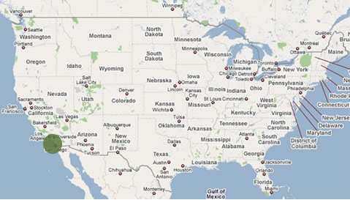
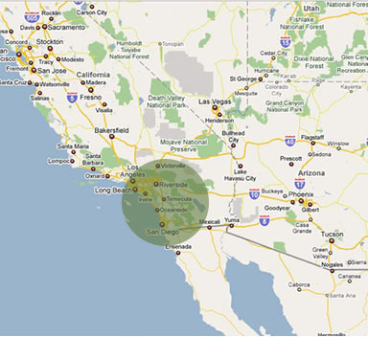
BUILDING INTRODUCTION
LOCATION
PRESENTATION OUTLINE
THESIS GOALS
BUILDING INTRO
STRUCTURAL DEPTH
CM BREADTH
ARCHITECTURAL BREADTH
SUMMARY
&
RECOMMENDATIONS
THANK YOU
QUESTIONS
Temecula, California
33.5°N 117.1°W
APRIL 13, 2009
SEAN BEVILLE
STRUCTURAL OPTION
ADVISOR: PROF. BOOTHBY

Slide 5
BUILDING INTRODUCTION
EXISTING CONDITIONS
PRESENTATION OUTLINE
THESIS GOALS
BUILDING INTRO
STRUCTURAL DEPTH
CM BREADTH
ARCHITECTURAL BREADTH
SUMMARY
&
RECOMMENDATIONS
THANK YOU
QUESTIONS
Lateral System
- Concrete Shear Walls 24” Thick
- Compressive Strength f’c, 7000 psi
Floor System
- Concrete Flat-Plate System
- 2-Story D&T Pre-Stressed Double-Tees
APRIL 13, 2009
SEAN BEVILLE
STRUCTURAL OPTION
ADVISOR: PROF. BOOTHBY

Slide 6
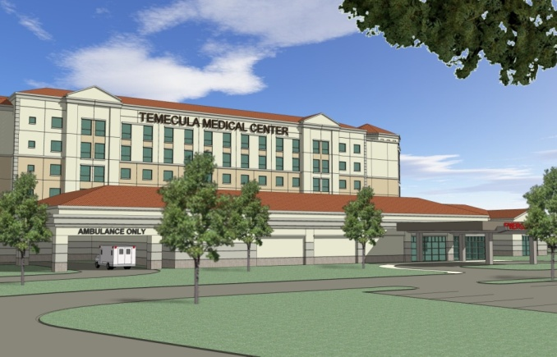
BUILDING INTRODUCTION
EXISTING CONDITIONS
PRESENTATION OUTLINE
THESIS GOALS
BUILDING INTRO
STRUCTURAL DEPTH
CM BREADTH
ARCHITECTURAL BREADTH
SUMMARY
&
RECOMMENDATIONS
THANK YOU
QUESTIONS
Roof System
- 16 Ga Composite Steel Deck
- 4 ½” Concrete Slab
Foundation
- Drilled Piers 42” Diameter
- Spread Footings 5’x5’ to 18’x18’
Columns
- 26”x26” cast-in-place
- Reinforced with #9 and #6 bars
APRIL 13, 2009
SEAN BEVILLE
STRUCTURAL OPTION
ADVISOR: PROF. BOOTHBY

Slide 7
BUILDING INTRODUCTION
BUILDING FUNCTIONS – 295,000 sq. ft.
PRESENTATION OUTLINE
THESIS GOALS
BUILDING INTRO
STRUCTURAL DEPTH
CM BREADTH
ARCHITECTURAL BREADTH
SUMMARY
&
RECOMMENDATIONS
THANK YOU
QUESTIONS
Floor 1
Entrance – ER – Exam Rooms
Floors 2-3
- Intensive Care Unit (ICU) – Exam Rooms – Offices
Floors 4-6
- Patient Rooms – Offices – Nurse Stations
APRIL 13, 2009
SEAN BEVILLE
STRUCTURAL OPTION
ADVISOR: PROF. BOOTHBY

Slide 8
STRUCTURAL DEPTH STUDY
OPTIMIZED SYSTEMS USING RAM STRUCTURAL SYSTEM
PRESENTATION OUTLINE
THESIS GOALS
BUILDING INTRO
STRUCTURAL DEPTH
CM BREADTH
ARCHITECTURAL BREADTH
SUMMARY
&
RECOMMENDATIONS
THANK YOU
QUESTIONS
Floor System
- Flat-plate to composite steel
- Concrete columns to steel columns
Lateral System
- Concrete shear walls to steel braced frames
APRIL 13, 2009
SEAN BEVILLE
STRUCTURAL OPTION
ADVISOR: PROF. BOOTHBY

Slide 9
STRUCTURAL DEPTH STUDY
OPTIMIZED SYSTEMS
PRESENTATION OUTLINE
THESIS GOALS
BUILDING INTRO
STRUCTURAL DEPTH
CM BREADTH
ARCHITECTURAL BREADTH
SUMMARY
&
RECOMMENDATIONS
THANK YOU
QUESTIONS
Composite Steel System
- Steel Columns
- 27’x26’ Typical Bays
Lateral System
- Concentric Diagonal Bracing
- Moment Frames
- HSS Steel Shapes
APRIL 13, 2009
SEAN BEVILLE
STRUCTURAL OPTION
ADVISOR: PROF. BOOTHBY

Slide 10
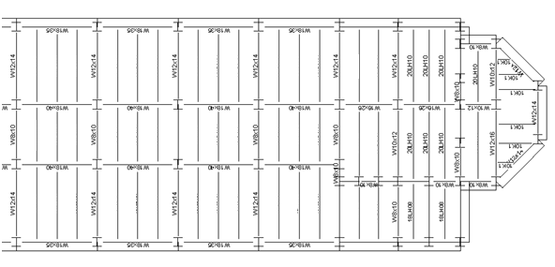
STRUCTURAL DEPTH STUDY
FLOOR LAYOUT
Typical Layout
- W18 Girders, W16 Joists
- 6” Slab (4” above deck)
PRESENTATION OUTLINE
THESIS GOALS
BUILDING INTRO
STRUCTURAL DEPTH
CM BREADTH
ARCHITECTURAL BREADTH
SUMMARY
&
RECOMMENDATIONS
THANK YOU
QUESTIONS
APRIL 13, 2009
SEAN BEVILLE
STRUCTURAL OPTION
ADVISOR: PROF. BOOTHBY

Slide 11
STRUCTURAL DEPTH STUDY
COLUMN LAYOUT
Typical Layout
- W10x33 → W12x79
- Limited to W10 when possible
PRESENTATION OUTLINE
THESIS GOALS
BUILDING INTRO
STRUCTURAL DEPTH
CM BREADTH
ARCHITECTURAL BREADTH
SUMMARY
&
RECOMMENDATIONS
THANK YOU
QUESTIONS
APRIL 13, 2009
SEAN BEVILLE
STRUCTURAL OPTION
ADVISOR: PROF. BOOTHBY

Slide 12
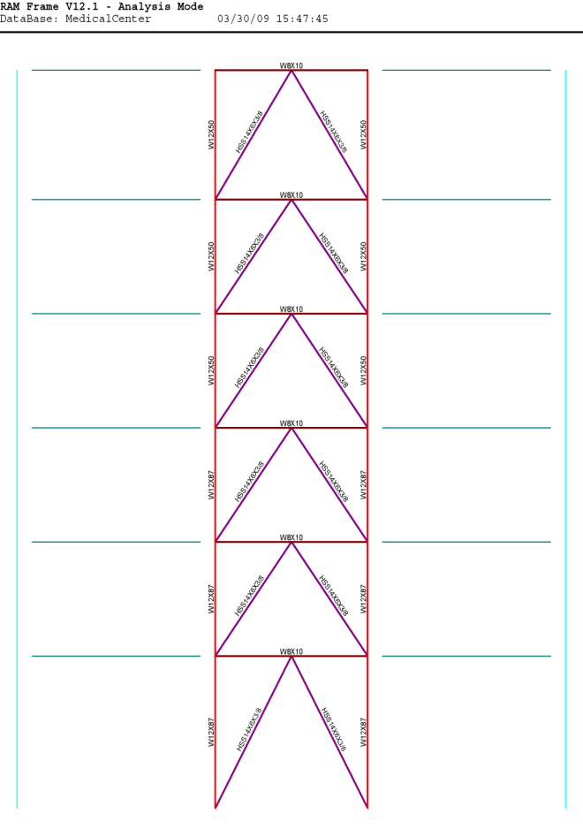
STRUCTURAL DEPTH STUDY
LATERAL SYSTEM
PRESENTATION OUTLINE
THESIS GOALS
BUILDING INTRO
STRUCTURAL DEPTH
CM BREADTH
ARCHITECTURAL BREADTH
SUMMARY
&
RECOMMENDATIONS
THANK YOU
QUESTIONS
Diagonal Bracing
- HSS 14”x6”x3/8”
- Concentric
Moment Frames
- W12 x 50/87
APRIL 13, 2009
SEAN BEVILLE
STRUCTURAL OPTION
ADVISOR: PROF. BOOTHBY

Slide 13
STRUCTURAL DEPTH STUDY
LATERAL SYSTEM
PRESENTATION OUTLINE
THESIS GOALS
BUILDING INTRO
STRUCTURAL DEPTH
CM BREADTH
ARCHITECTURAL BREADTH
SUMMARY
&
RECOMMENDATIONS
THANK YOU
QUESTIONS
Typical Chevron Bracing
Consistent member contribution
Adequate deflections < 3.3”
 | X-Direction |  | Y-Direction
 | Controlled by Seismic |  | Controlled by Seismic
Story | Story Drift | Displacement | Story Drift | Displacement
6 | 0.68 | 3.12 | 0.51 | 2.79
5 | 0.64 | 2.51 | 0.48 | 2.23
4 | 0.64 | 1.95 | 0.48 | 1.71
3 | 0.61 | 1.39 | 0.45 | 1.19
2 | 0.52 | 0.86 | 0.37 | 0.71
1 | 0.49 | 0.41 | 0.31 | 0.32
APRIL 13, 2009
SEAN BEVILLE
STRUCTURAL OPTION
ADVISOR: PROF. BOOTHBY

Slide 14
STRUCTURAL DEPTH STUDY
LAYOUT MODIFICATIONS
PRESENTATION OUTLINE
THESIS GOALS
BUILDING INTRO
STRUCTURAL DEPTH
CM BREADTH
ARCHITECTURAL BREADTH
SUMMARY
&
RECOMMENDATIONS
THANK YOU
QUESTIONS
Typical Floors
Floor-to-floor heights increased by 12”
Column sizes smaller = more space
Thinner lateral-structure
APRIL 13, 2009
SEAN BEVILLE
STRUCTURAL OPTION
ADVISOR: PROF. BOOTHBY

Slide 15
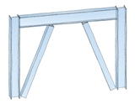
STRUCTURAL DEPTH STUDY
RESULTS & RECOMMENDATIONS
PRESENTATION OUTLINE
THESIS GOALS
BUILDING INTRO
STRUCTURAL DEPTH
CM BREADTH
ARCHITECTURAL BREADTH
SUMMARY
&
RECOMMENDATIONS
THANK YOU
QUESTIONS
Floor System
- Explore slab – joist combinations
- Non – composite system
Lateral System
- Eccentric bracing
- Fewer/larger steel braces
APRIL 13, 2009
SEAN BEVILLE
STRUCTURAL OPTION
ADVISOR: PROF. BOOTHBY

Slide 16
CONSTRUCTION MANAGEMENT BREADTH
MATERIAL TAKEOFFS
PRESENTATION OUTLINE
THESIS GOALS
BUILDING INTRO
STRUCTURAL DEPTH
CM BREADTH
ARCHITECTURAL BREADTH
SUMMARY
&
RECOMMENDATIONS
THANK YOU
QUESTIONS
Existing System
- R.S. Means estimates
- Typical concrete construction
Steel Re-design
- RAM Structural System
- Weight takeoffs
APRIL 13, 2009
SEAN BEVILLE
STRUCTURAL OPTION
ADVISOR: PROF. BOOTHBY

Slide 17
CONSTRUCTION MANAGEMENT BREADTH
MATERIAL & LABOR COSTS
PRESENTATION OUTLINE
THESIS GOALS
BUILDING INTRO
STRUCTURAL DEPTH
CM BREADTH
ARCHITECTURAL BREADTH
SUMMARY
&
RECOMMENDATIONS
THANK YOU
QUESTIONS
R.S. Means – 2008
Assumptions
- Steel - $0.50/lb
Takeoffs from 4 Groups
Columns
Slabs
Shear walls – Diagonal Bracing
Crane/Equipment
APRIL 13, 2009
SEAN BEVILLE
STRUCTURAL OPTION
ADVISOR: PROF. BOOTHBY

Slide 18
CONSTRUCTION MANAGEMENT BREADTH
COSTS
PRESENTATION OUTLINE
THESIS GOALS
BUILDING INTRO
STRUCTURAL DEPTH
CM BREADTH
ARCHITECTURAL BREADTH
SUMMARY
&
RECOMMENDATIONS
THANK YOU
QUESTIONS
TOTAL – $3.8 Million
TOTAL – $2.3 Million
TOTAL SAVINGS – $1.53 Million
$5.2/sq. ft.
APRIL 13, 2009
SEAN BEVILLE
STRUCTURAL OPTION
ADVISOR: PROF. BOOTHBY

Slide 19
CONSTRUCTION MANAGEMENT BREADTH
SCHEDULING
PRESENTATION OUTLINE
THESIS GOALS
BUILDING INTRO
STRUCTURAL DEPTH
CM BREADTH
ARCHITECTURAL BREADTH
SUMMARY
&
RECOMMENDATIONS
THANK YOU
QUESTIONS
Concrete Existing
261 Days
Steel Re-Design
208 Days
Savings
53 Days
2.7 Months
@ $60,000/Month = $198,000 in scheduling savings
APRIL 13, 2009
SEAN BEVILLE
STRUCTURAL OPTION
ADVISOR: PROF. BOOTHBY

Slide 20
CONSTRUCTION MANAGEMENT BREADTH
CONCLUSIONS
PRESENTATION OUTLINE
THESIS GOALS
BUILDING INTRO
STRUCTURAL DEPTH
CM BREADTH
ARCHITECTURAL BREADTH
SUMMARY
&
RECOMMENDATIONS
THANK YOU
QUESTIONS
Total Savings
- $1.53 Million ($5.2/sq. ft.)
Additional Savings
- Scheduling impact
- Early move-in, Foundations
Disadvantages of Steel
- Lead time
- Increased height
- Staging area
APRIL 13, 2009
SEAN BEVILLE
STRUCTURAL OPTION
ADVISOR: PROF. BOOTHBY

Slide 21
CONSTRUCTION MANAGEMENT BREADTH
CONCLUSIONS & RECOMMENDATIONS
PRESENTATION OUTLINE
THESIS GOALS
BUILDING INTRO
STRUCTURAL DEPTH
CM BREADTH
ARCHITECTURAL BREADTH
SUMMARY
&
RECOMMENDATIONS
THANK YOU
QUESTIONS
Composite Steel Is Viable
Flexible Savings
Further Investigation Recommended
APRIL 13, 2009
SEAN BEVILLE
STRUCTURAL OPTION
ADVISOR: PROF. BOOTHBY

Slide 22
ARCHITECTURAL BREADTH
OPTIMIZED SYSTEMS
PRESENTATION OUTLINE
THESIS GOALS
BUILDING INTRO
STRUCTURAL DEPTH
CM BREADTH
ARCHITECTURAL BREADTH
SUMMARY
&
RECOMMENDATIONS
THANK YOU
QUESTIONS
Existing Condition
- Plaster façade
- Minimal window coverage
Re-Design
- Predominantly glass
- Extensions for shade
LIFE SCIENCES BUILDING
APRIL 13, 2009
SEAN BEVILLE
STRUCTURAL OPTION
ADVISOR: PROF. BOOTHBY

Slide 23
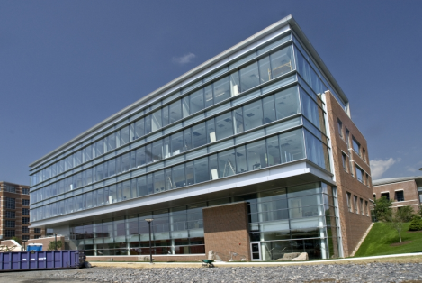
ARCHITECTURAL BREADTH
OPTIMIZED SYSTEMS
PRESENTATION OUTLINE
THESIS GOALS
BUILDING INTRO
STRUCTURAL DEPTH
CM BREADTH
ARCHITECTURAL BREADTH
SUMMARY
&
RECOMMENDATIONS
THANK YOU
QUESTIONS
Glass Façade Re-Design
- Regional architecture
- Sun study
- Penn State study
HEALTH SERVICES BUILDING
APRIL 13, 2009
SEAN BEVILLE
STRUCTURAL OPTION
ADVISOR: PROF. BOOTHBY

Slide 24
ARCHITECTURAL BREADTH
OPTIMIZED SYSTEMS
PRESENTATION OUTLINE
THESIS GOALS
BUILDING INTRO
STRUCTURAL DEPTH
CM BREADTH
ARCHITECTURAL BREADTH
SUMMARY
&
RECOMMENDATIONS
THANK YOU
QUESTIONS
Glass Façade Re-Design
- 79° sun angle
- 8’ windows
APRIL 13, 2009
SEAN BEVILLE
STRUCTURAL OPTION
ADVISOR: PROF. BOOTHBY

Slide 25
ARCHITECTURAL BREADTH
CONCLUSIONS AND RECOMMENDATIONS
PRESENTATION OUTLINE
THESIS GOALS
BUILDING INTRO
STRUCTURAL DEPTH
CM BREADTH
ARCHITECTURAL BREADTH
SUMMARY
&
RECOMMENDATIONS
THANK YOU
QUESTIONS
New architectural approach for region
Increased sunlight → heat
Less efficient than original design
Further investigation not recommended
APRIL 13, 2009
SEAN BEVILLE
STRUCTURAL OPTION
ADVISOR: PROF. BOOTHBY

Slide 26
SUMMARY & RECOMMENDATIONS
GOALS
PRESENTATION OUTLINE
THESIS GOALS
BUILDING INTRO
STRUCTURAL DEPTH
CM BREADTH
ARCHITECTURAL BREADTH
SUMMARY
&
RECOMMENDATIONS
THANK YOU
QUESTIONS
Analysis existing conditions/surrounding region
Existing conditions explored and verified
Systems studied for comparison
Optimize new steel structure
Re-designed steel member sizes determined
More efficient lateral system
Further investigation recommended
APRIL 13, 2009
SEAN BEVILLE
STRUCTURAL OPTION
ADVISOR: PROF. BOOTHBY

Slide 27
SUMMARY & RECOMMENDATIONS
GOALS
PRESENTATION OUTLINE
THESIS GOALS
BUILDING INTRO
STRUCTURAL DEPTH
CM BREADTH
ARCHITECTURAL BREADTH
SUMMARY
&
RECOMMENDATIONS
THANK YOU
QUESTIONS
Analyze construction feasibility of new system
Steel system very efficient
Lower final costs and construction times
Further investigation recommended
Enhance exterior architecture
Adds appeal to region
Allows more incoming light
Original design – more efficient operating costs
Further investigation not recommended
APRIL 13, 2009
SEAN BEVILLE
STRUCTURAL OPTION
ADVISOR: PROF. BOOTHBY

Slide 28
THANK YOU
PRESENTATION OUTLINE
THESIS GOALS
BUILDING INTRO
STRUCTURAL DEPTH
CM BREADTH
ARCHITECTURAL BREADTH
SUMMARY
&
RECOMMENDATIONS
THANK YOU
QUESTIONS
Special thanks to
HKS Inc.
Penn State University
Prof. Parfitt
Prof. Holland
Prof. Boothby
Friends and Family
APRIL 13, 2009
SEAN BEVILLE
STRUCTURAL OPTION
ADVISOR: PROF. BOOTHBY

Slide 29
QUESTIONS
PRESENTATION OUTLINE
THESIS GOALS
BUILDING INTRO
STRUCTURAL DEPTH
CM BREADTH
ARCHITECTURAL BREADTH
SUMMARY
&
RECOMMENDATIONS
THANK YOU
QUESTIONS
QUESTIONS?
APRIL 13, 2009
SEAN BEVILLE
STRUCTURAL OPTION
ADVISOR: PROF. BOOTHBY

